Slide 1


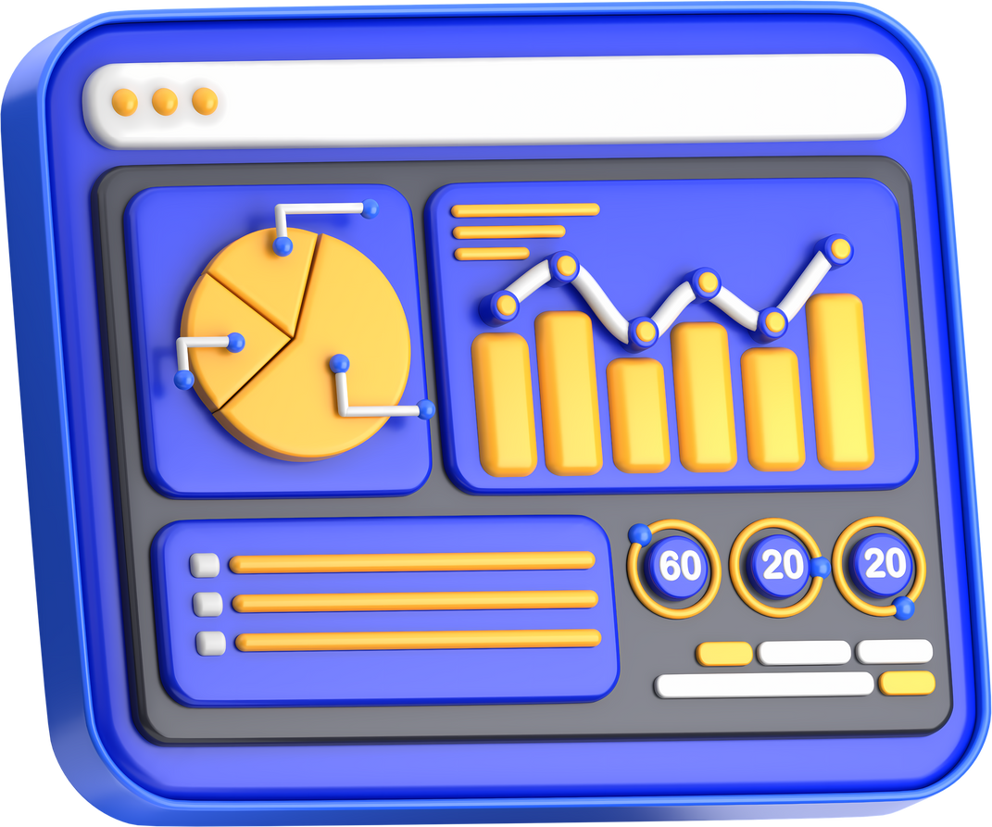

CAI3_DAT2_G5 Team 2
HR Analytics Executive Report
One dashboard to monitor employee data, performance, and growth.
Powered by Power BI
Team
Agenda
Summary
Project Phases
Recommendations
Touch Us

Slide 2





Team Members
Taher Abdelfattah
Sr. Documents Management
Maged Mohamed
Sr. BI Developer
Sandra Shenouda
Admission Specialist
Mahmoud Abdelqader
Head of procurement

Slide 3
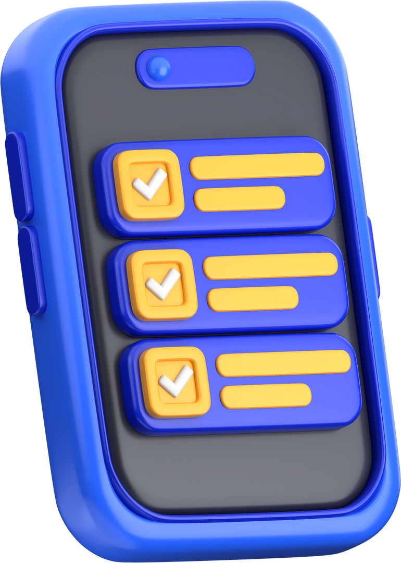


Table of Content
01
Executive Summary
05
Key Metrics & Performance
02
Project creation Phases
06
Visual Insights
03
Business Objectives
07
Strategic Recommendations
04
Data Overview
08
Appendix

Slide 4
Executive Summary
This report provides a holistic overview of our workforce, highlighting critical areas in employee attrition, compensation, and demographic distribution. The data reveals a healthy overall retention rate but points to specific departments, ethnicities, and work-life balance factors that require targeted intervention to mitigate risk and foster a more stable and engaged workforce.
1. Attrition & Retention: A Strong Baseline with Specific Vulnerabilities
The company maintains a solid foundation with 1,470 total employees and an 84% active employee rate, indicating an overall attrition rate of 16%. However, this figure masks significant disparities:
Departmental Risk: Attrition is concentrated, with 237 employees leaving from a single, high-risk department (likely Sales or a specific technical unit), suggesting issues with role-specific stress, compensation, or management.
Ethnicity Disparity: Attrition is not evenly distributed across ethnic groups. While raw numbers are highest among White employees, the American Indian or Alaska Native group shows a concerning trend, with 20 out of 50 employees (40%) having left.
Tenure Insights: The average tenure hovers around 4.56 years, with variations by age group. This indicates a potential risk period mid-career where employees may seek new opportunities.

Slide 5
Executive Summary
2. Compensation & Workload: Key Levers for Retention
Compensation and overtime are critical factors influencing employee satisfaction and turnover.
Compensation Distribution: The majority of the salary budget is allocated to Sales and Engineering roles. This is expected but requires ongoing benchmarking to ensure competitiveness.
Overtime Concerns: A significant portion of the workforce (28.3%) works overtime. A high correlation often exists between mandatory overtime, burnout, and attrition, necessitating a review of workload distribution and staffing levels.
Steady Payroll Growth: Total salary expenditure has shown a consistent upward trend from 2014 to 2022, reflecting company growth and incremental increases, but it may not be targeted enough to retain key talent in competitive roles.

Slide 6
Executive Summary
3. Workforce Composition & Demographics
Our workforce is diverse, with several key characteristics:
Gender Balance: The workforce is relatively balanced between males and females (651 vs. 675), with inclusive representation of non-binary individuals and those who prefer not to specify.
Marital Status: The largest employee groups are Married and Single.
Business Travel: A significant majority (~88%) of employees engage in business travel, with 10.6% classified as "Frequent Travelers." The impact of this travel on work-life balance and attrition, especially for roles with high travel, should be investigated.

Slide 7
Project creation Phases
1️⃣ Requirements Gathering Phase
Conduct meetings with team members (Stakeholders)
Identify the key questions the dashboard must answer
Define the KPIs
Identify the data sources
2️⃣ Data Modeling Planning Phase
Identify the required tables
Design the Star Schema
Define the required transformations (ETL List)
3️⃣ ETL Phase (Extract – Transform – Load)
Extract
Transform
Load

Slide 8
Project creation Phases
4️⃣ Data Modeling Phase in Power BI
Build the Star Schema model
Create Measures using DAX
5️⃣ Visualization Phase (Dashboard Design)
Choose the overall design (Theme)
Create the dashboard pages
Select the appropriate visuals
Add interactivity (Interactions)
6️⃣ Delivery & Documentation Phase
Deliver the final ready-to-use dashboard
Prepare a documentation file that includes:

Slide 9
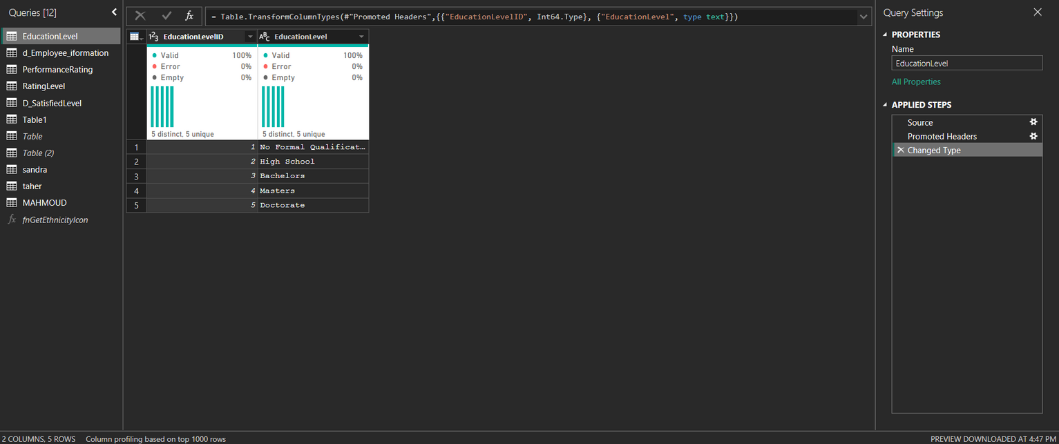
ETL Phase (Extract – Transform – Load)
Education Level Table - ETL Steps:
1️⃣ Source
The Education Level dimension table is imported.
2️⃣ Promoted Headers
First row → column headers.
3️⃣ Changed Type
EducationLevelID → Whole Number - EducationLevel → Text

Slide 10
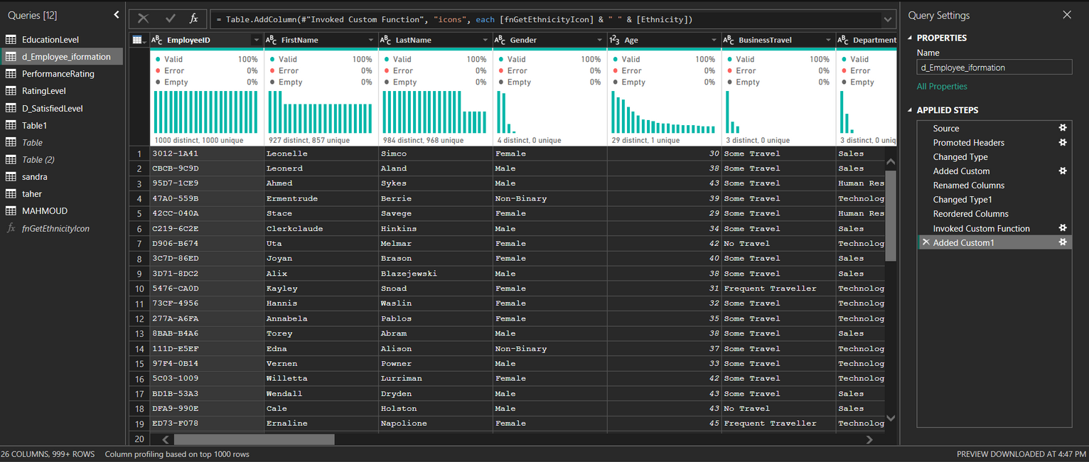
ETL Phase (Extract – Transform – Load)
Employee Information Table — ETL Steps
1️⃣ Source
The employee dataset is imported from the source.
2️⃣ Promoted Headers
The first row is promoted to column headers (FirstName, LastName, Gender, Age, etc.).
3️⃣ Changed Type
Data types are assigned:
EmployeeID → Text
Age → Number
BusinessTravel → Text - Department → Text

Slide 11
ETL Phase (Extract – Transform – Load)
4️⃣ Added Custom – Custom Column Addition
A new column was created using a Custom Column formula that was entered manually in Power Query.
This step simply indicates the creation of a new column, without specifying its purpose.
5️⃣ Renamed Columns
Columns were renamed to match the naming standards used in the data model.
6️⃣ Changed Type1
Data types were adjusted again—usually done after creating or modifying columns.
7️⃣ Reordered Columns
Columns were reorganized to follow a logical order (EmployeeID first, followed by personal and job-related fields).
8️⃣ Invoked Custom Function
A custom function (fnGetEthnicityIcon) was invoked.
This function generates an icon or symbol based on the Ethnicity field.
9️⃣ Added Custom1
Another new column was created by combining:
fnGetEthnicityIcon & " " & [Ethnicity]
This produces a field containing both the icon and the ethnicity value.

Slide 12
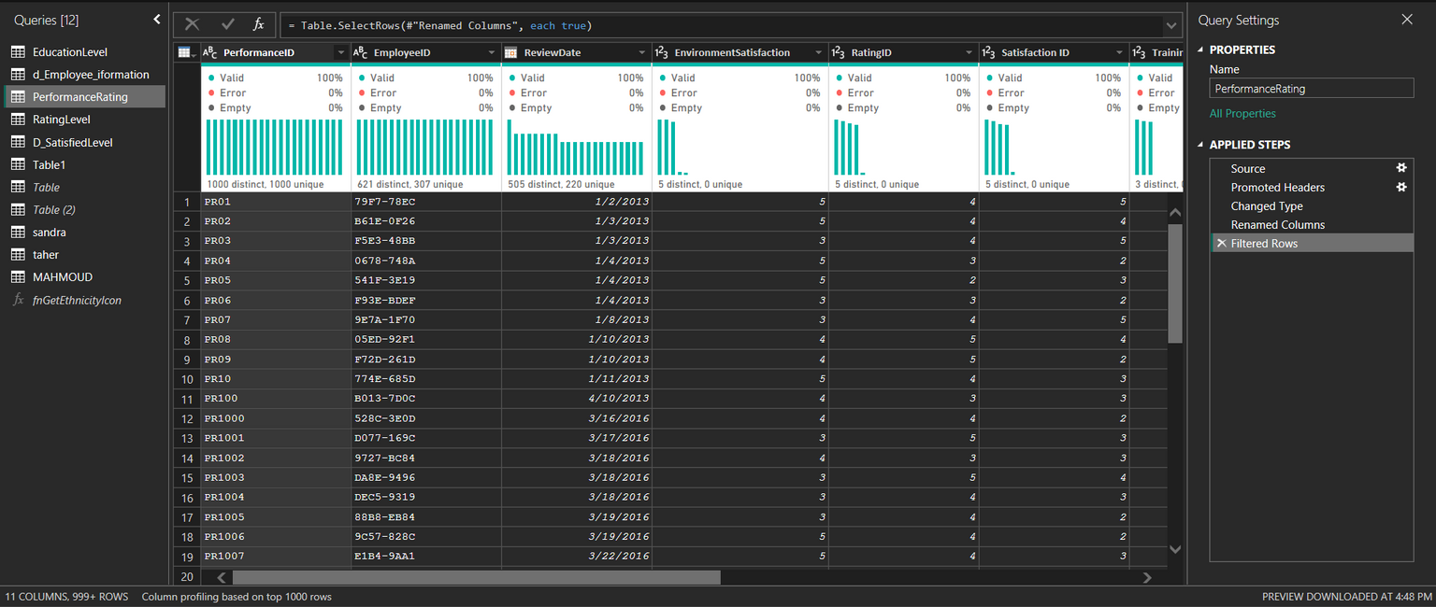
ETL Phase (Extract – Transform – Load)
Performance Rating Table — ETL Steps
1️⃣ Source
The data is imported from the original source (Excel, CSV, or database).
This produces a raw table containing the columns exactly as they appear in the source file.
2️⃣ Promoted Headers
Converts the first row into column headers.
Typically, this row contains names such as PerformanceID, EmployeeID, ReviewDate, etc.

Slide 13
ETL Phase (Extract – Transform – Load)
3️⃣ Changed Type
Power Query automatically assigns data types to each column.
ReviewDate → Date
RatingID → Whole Number
EnvironmentSatisfaction → Whole Number
4️⃣ Renamed Columns
Some columns were renamed to more meaningful or standardized names that better suit the data model.
5️⃣ Filtered Rows
Filters were applied (such as removing null values or invalid entries).
You may have filtered specific years or valid values only.

Slide 14
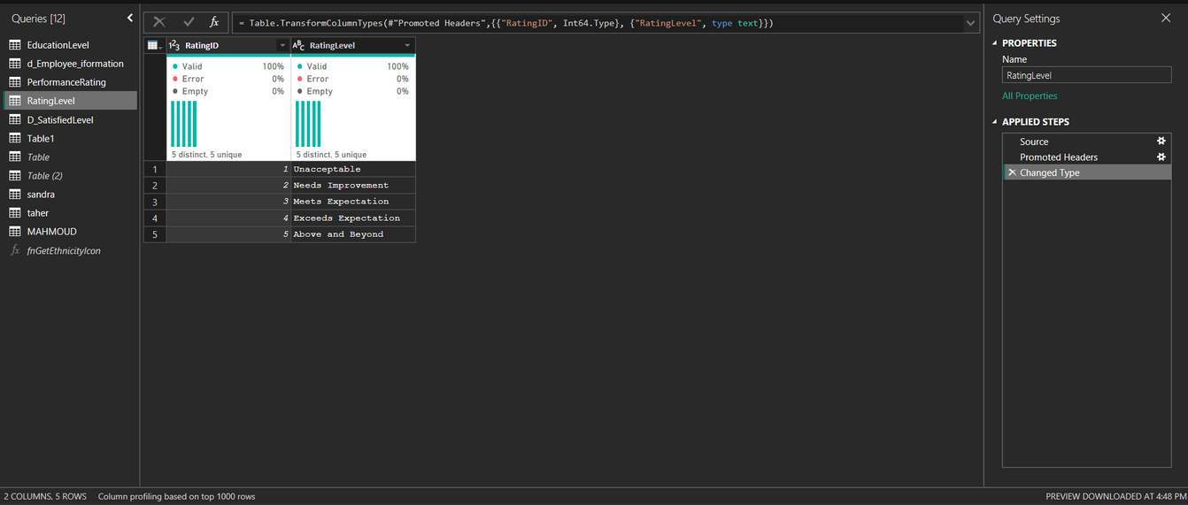
ETL Phase (Extract – Transform – Load)
Rating Level Table - ETL Steps:
1️⃣ Promoted Headers
Convert the first row into column headers:
RatingID - RatingLevel
2️⃣ Changed Type
RatingID → Number
RatingLevel → Text

Slide 15
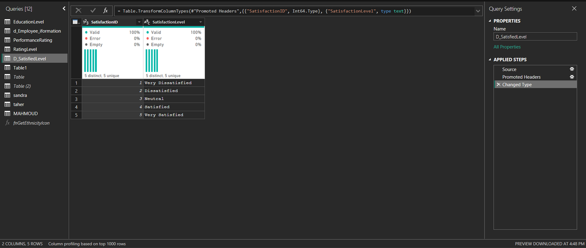
ETL Phase (Extract – Transform – Load)
Satisfied Level Table – ETL Steps:
1️⃣ Promoted Headers
Convert the first row into column headers.
The columns become:
SatisfactionID
SatisfactionLevel
2️⃣ Changed Type
Change the data type for each column:
SatisfactionID → Number (Int64)
SatisfactionLevel → Text

Slide 16
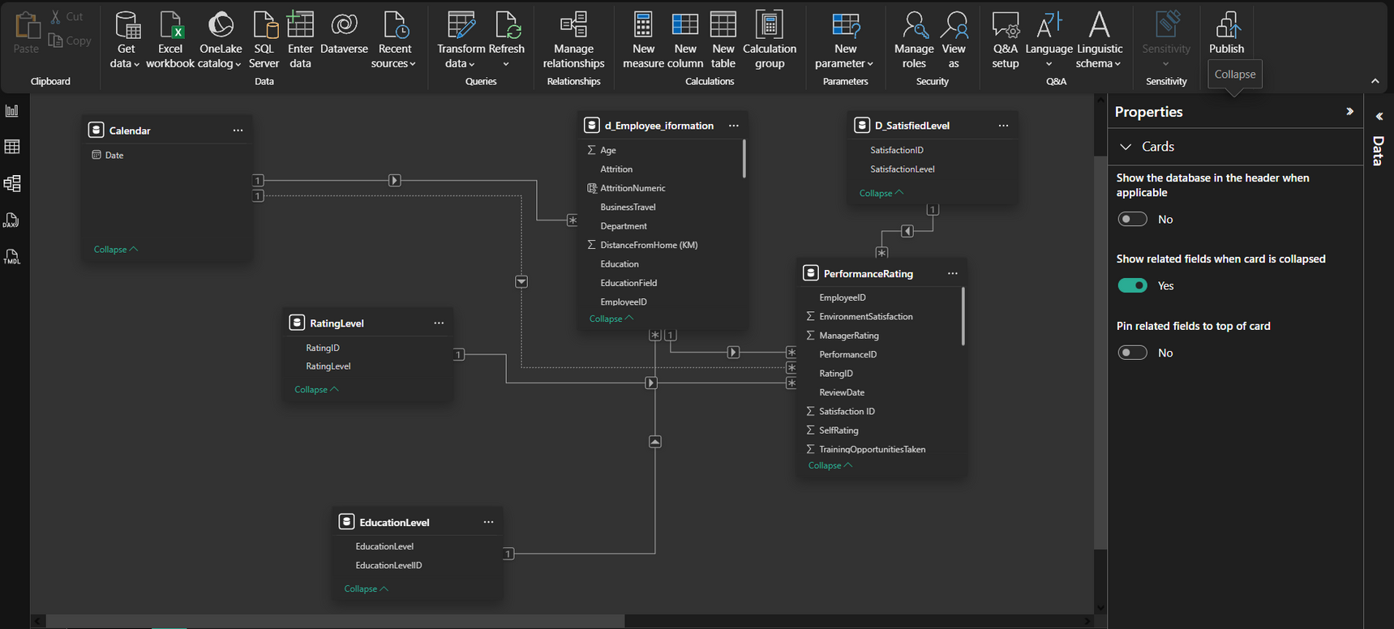
Data Modeling Phase - Build the Star Schema model
🔗 Relationships in the Star Schema

Slide 17
ETL Phase (Extract – Transform – Load)
🔗 Relationships in the Star Schema
Fact Table:
PerformanceRating
Dimension Tables:
Employee_information / RatingLevel / SatisfiedLevel/ EducationLevel
From | To | Relationship
PerformanceRating | d_Employee_information | EmployeeID = EmployeeID
PerformanceRating | RatingLevel | RatingID = RatingID
PerformanceRating | D_SatisfiedLevel | SatisfactionID = SatisfactionID
d_Employee_information | EducationLevel | EducationLevelID = EducationLevelID
PerformanceRating | Calendar | ReviewDate = Date

Slide 18
Data Modeling Phase - Create Measures using DAX
Measures Summary
1. Males Expression: COUNTROWS(FILTER('d_Employee_iformation', d_Employee_iformation[Gender] = "Male")) Purpose: Counts the number of male employees.
2. females Expression: COUNTROWS(FILTER('d_Employee_iformation', d_Employee_iformation[Gender] = "Female")) Purpose: Counts the number of female employees.
3. total salary Expression: SUM(d_Employee_Information [Salary]) Purpose: Calculates the total salary for all employees.
4. Active_Employees Expression: CALCULATE(COUNT(d_Employee_iformation[EmployeeID]), d_Employee_iformation[Attrition] = "No") Purpose: Counts the number of active employees (those who have not left the company).
5. Active_Employees_Percentage Expression: DIVIDE( CALCULATE(COUNT(d_Employee_iformation[EmployeeID]), d_Employee_iformation[Attrition] = "No"), COUNT(d_Employee_iformation[EmployeeID]) ) Purpose: Calculates the percentage of active employees out of the total employees.

Slide 19
Data Modeling Phase - Create Measures using DAX
6. BACHELORS Expression: CALCULATE(COUNTROWS(d_Employee_Information), EducationLevel[EducationLevel] = "Bachelors") Purpose: Counts employees whose education level is Bachelor's degree.
7. Doctorate Expression: CALCULATE(COUNTROWS(d_Employee_Information), EducationLevel[EducationLevel] = "Doctorate") Purpose: Counts employees with a Doctorate degree.
8. High School Expression: CALCULATE(COUNTROWS(d_Employee_Information), EducationLevel[EducationLevel] = "High School") Purpose: Counts employees whose education level is High School.
9. Master's Expression: CALCULATE(COUNTROWS(d_Employee_Information), EducationLevel[EducationLevel] = "Master's") Purpose: Counts employees with a Master’s degree.
10. No Formal Qualifications Expression: CALCULATE(COUNTROWS(d_Employee_Information), EducationLevel[EducationLevel] = "No Formal Qualifications") Purpose: Counts employees with no formal educational qualifications.

Slide 20
Data Modeling Phase - Create Measures using DAX
11. HR_Rating_Count (the one using RatingLevel + HR filter) Expression: CALCULATE( COUNT(RatingLevel[RatingLevel]), FILTER(d_Employee_iformation, d_Employee_iformation[Department] = "Human Resources") ) Purpose: Counts rating entries for employees working in the Human Resources department.
12. Total Employees Expression: COUNT(d_Employee_iformation[EmployeeID]) Purpose: Counts the total number of employees.
13. Attrition_Employees Expression: CALCULATE(COUNT(d_Employee_iformation[EmployeeID]), d_Employee_iformation[Attrition] = "Yes") Purpose: Counts employees who have left the company.
14. Attrition_Percentage Expression: DIVIDE([Attrition_Employees], [Total Employees]) Purpose: Calculates the percentage of employees who left the company.
15. Average Rating Expression: AVERAGE(RatingLevel[RatingID]) Purpose: Calculates the average rating score.

Slide 21
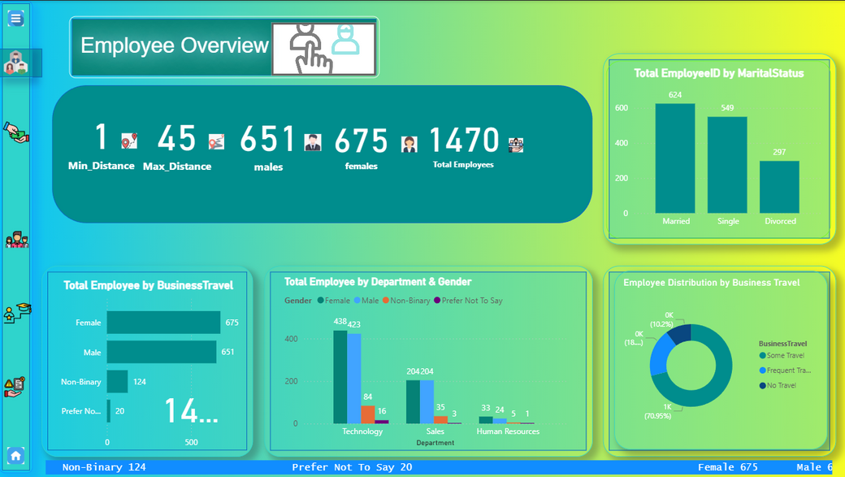
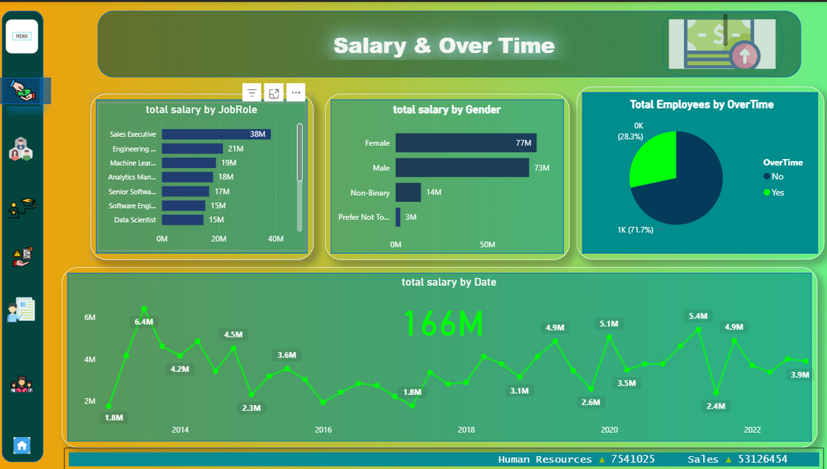
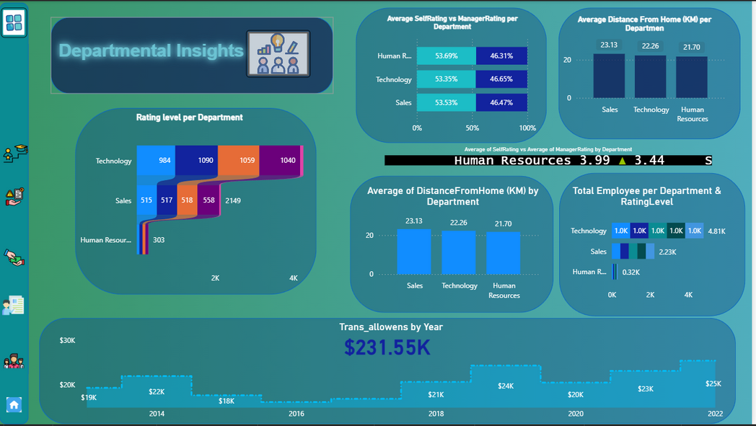
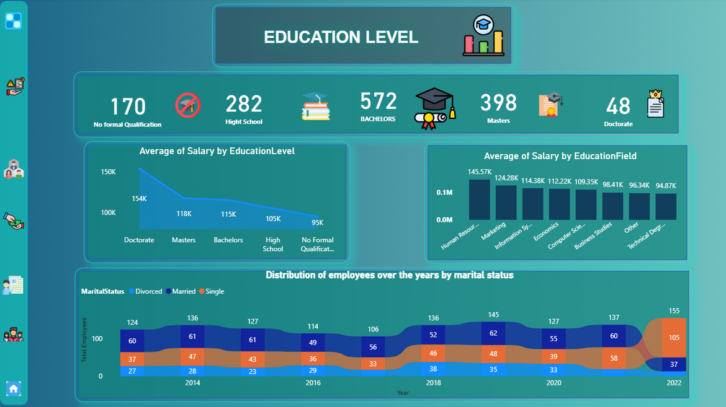
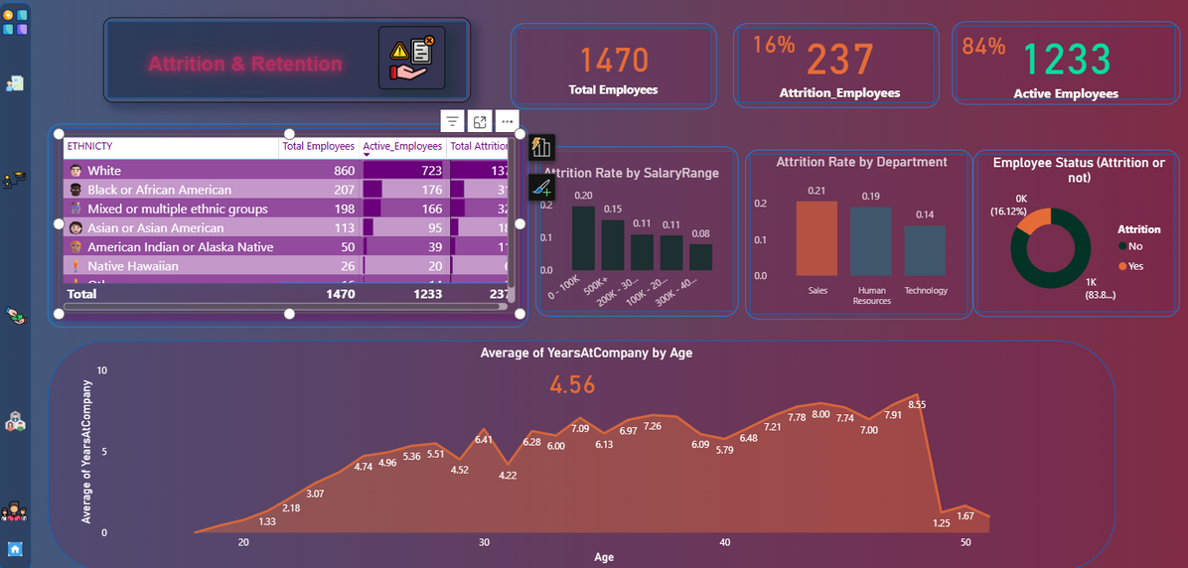
Visualization Phase (Dashboard Design)

Slide 22
Visualization Phase (Description, KPIs and Recommendations)
📋 Dashboard Description
The Employee Overview Dashboard provides a comprehensive snapshot of the workforce across key demographics and organizational dimensions. It consolidates employee counts, gender distribution, travel behavior, departmental structure, and marital status to support strategic HR decision-making.
The visuals combine summary cards, bar charts, and donut charts to give leaders a balanced and clear understanding of employee distribution patterns across the company.

Slide 23
Visualization Phase (Description, KPIs and Recommendations)
📊 Key Performance Indicators (KPIs)
1. Total Workforce
Total Employees: 1,470
Male Employees: 651
Female Employees: 675
Non-Binary: 124
Prefer Not to Say: 20
2. Distance to Work
Minimum Distance: 1 km
Maximum Distance: 45 km
3. Marital Status Distribution
Married: 624
Single: 549
Divorced: 297
4. Business Travel Activity
Some Travel: ~70.95% (~1,000 employees)
Frequent Travel: ~18% (~260 employees)
No Travel: ~10.2% (~150 employees)
5. Employee Distribution by Department & Gender
Technology Department:
Female: 438
Male: 384
Non-Binary: 84
Prefer Not to Say: 16
Sales Department:
Female: 204
Male: 183
Non-Binary: 35
Prefer Not to Say: 3
Human Resources:
Female: 33
Male: 24
Non-Binary: 5
Prefer Not to Say: 1

Slide 24
Visualization Phase (Description, KPIs and Recommendations)
💡 Recommendations
1. Strengthen Diversity & Inclusion Programs
There is healthy gender representation, but non-binary and “prefer not to say” responses indicate a need for clearer inclusion policies or more confidence in disclosure.
Conduct internal surveys to understand inclusion perceptions.
2. Review Travel Policies
With over 70% traveling, consider:
Streamlining business travel approvals
Offering flexible travel alternatives
Monitoring travel-related fatigue and burnout
3. Optimize Workforce Distribution
Technology and Sales show high employee concentrations.
Assess workload balance, especially where one gender is dominant, to promote inclusive teams.
4. Address High Commute Distances
With travel distances reaching up to 45 km, consider:
Remote/hybrid work flexibility
Transportation allowances
Shuttle or corporate transportation services
5. Support for Single & Divorced Employees
Large single and divorced segments may benefit from:
Wellness programs
Work–life balance initiatives
Social support activities
6. Future Dashboards to Add
Attrition rate
New hires vs. exits
Performance rating overview
Training and development participation

Slide 25
Visualization Phase (Description, KPIs and Recommendations)
📋 Dashboard Description
The Salary & Overtime Dashboard provides a detailed financial overview of employee compensation patterns across job roles, gender groups, and time periods.
It also highlights the distribution of employees working overtime, enabling HR and finance teams better to manage workload balance, staffing costs, and budgeting.
The dashboard combines bar, trendline, and donut charts to provide insights into total salaries paid, overtime participation, and historical salary trends.

Slide 26
Visualization Phase (Description, KPIs and Recommendations)
📊 Key Performance Indicators (KPIs)
1. Total Salary Expenditure
Total Salary Paid: 166M
2. Salary by Gender
Female: 77M
Male: 73M
Non-Binary: 14M
Prefer Not to Say: 3M
3. Salary by Job Role (Top Contributors)
Sales Executive: 38M
Engineering Roles: 21M
Machine Learning Specialist: 19M
Analytics Manager: 18M
Senior Software Engineers: 17M
Software Engineers: 15M
Data Scientists: 15M
4. Employee Overtime Participation
No Overtime: 71.7% (~1,000 employees)
Yes Overtime: 28.3% (~400 employees)
5. Salary Trend Over the Years
Peak salaries: 6.4M, 5.4M, 5.1M, 4.9M
Lowest year value: 1.8M
This indicates fluctuating salary spending over time with noticeable peaks and dips.

Slide 27
Visualization Phase (Description, KPIs and Recommendations)
💡 Recommendations
1. Assess Gender Pay Patterns
Female and male salary totals are close (77M vs 73M), but deeper analysis is needed to ensure:
Equal pay within the same job roles
No systemic pay gaps in promotions or bonuses
Transparent compensation policies
2. Monitor High-Cost Job Roles
Sales Executives account for 38M — significantly higher than any other role.
Recommended actions:
Evaluate commission structures
Validate productivity and ROI
Review compensation competitiveness for engineering and analytics roles to support talent retention
3. Manage Overtime More Effectively
With 28.3% employees working overtime, this may indicate:
Workload imbalance
Staff shortages in certain departments
Long-term risk of burnout
Suggested actions:
Improve workforce planning
Introduce overtime limits
Offer flexible scheduling or shift rotations
Automate repetitive workflows where possible
4. Stabilize Salary Fluctuations Over Time
The salary trend shows significant ups and downs, suggesting:
Seasonal hiring patterns
Inconsistent bonus or overtime strategies
Project-driven cost spikes

Slide 28
Visualization Phase (Description, KPIs and Recommendations)
📋 Dashboard Description
The Departmental Insights Dashboard provides a comprehensive analytical view of key performance metrics across the Technology, Sales, and Human Resources departments.
It highlights rating distributions, employee performance comparisons between self-ratings and manager ratings, average commuting distances, and departmental headcounts.
The dashboard also tracks yearly transportation allowances, offering a financial perspective on employee benefits.
Through visual insights—including stacked rating charts, bar graphs, and time-series financial trends—the dashboard supports strategic HR planning, workforce management, and performance evaluation.

Slide 29
Visualization Phase (Description, KPIs and Recommendations)
📊 Key Performance Indicators (KPIs)
1. Average Ratings
Average Self-Rating (All Departments): ~53%
Average Manager Rating (All Departments): ~46%
Difference: ~7% higher employee self-rating
2. Department-Level Rating Metrics
Human Resources:
Average Self Rating: 3.99
Average Manager Rating: 3.44
Technology Department:
Rating levels approx: 984, 1090, 1059, 1040 (total 4.18K)
Sales Department:
Rating levels approx: 515, 517, 518, 558 (total 2.23K)
HR Department:
Rating levels approx: 303 total
3. Average Distance From Home (KM)
Sales: 23.13 km
Technology: 22.26 km
Human Resources: 21.70 km
Differences between departments are minimal (<2 km)
4. Department Size (Total Employees)
Technology: 4.81K employees
Sales: 2.23K employees
Human Resources: 0.32K employees
5. Transport Allowances Over Time
Total Transport Allowance Paid: $231.55K
Yearly range: $18K – $30K
The trend shows a gradual increase toward 2022

Slide 30
Visualization Phase (Description, KPIs and Recommendations)
💡 Recommendations
1. Address the Gap Between Self & Manager Ratings
Employees consistently rate themselves higher than managers do (≈7% difference).
This may indicate:
Misalignment in performance expectations
Insufficient feedback frequency
Lack of standardized evaluation criteria
Recommendation:
Implement calibration sessions and training for managers to ensure consistent rating standards.
2. Strengthen HR Department Capacity
HR has the smallest workforce (320 employees) compared to Technology (4.8K) and Sales (2.2K).
A small HR team supporting a large workforce may lead to:
Overload on HR staff
Slower issue resolution
Higher risk of employee dissatisfaction
Recommendation:
Evaluate HR staffing levels and automate repetitive HR tasks using HRIS systems.
3. Address High Commute Distances
Average distances (~22–23 km) may contribute to:
Fatigue
Lower punctuality
Higher turnover risks
Recommendation:
Introduce:
Partial remote-work options
Transport stipends (already tracked)
Shuttle services for peak routes

Slide 31
Visualization Phase (Description, KPIs and Recommendations)
4. Continue Monitoring Transport Allowances
The allowances show fluctuations but a general upward trend toward $25K–$30K.
This increase may be tied to:
Inflation
Fuel prices
Growth in employee count
Recommendation:
Regularly reassess transport allowances to maintain fairness and cost control.
5. Explore Rating Level Patterns
Technology has the largest number of employees across all rating levels.
Sales have a moderate distribution, while HR is significantly lower.
Recommendation:
Use these patterns to:
Identify training needs
Track high-performer clusters
Plan promotions and succession pipelines

Slide 32
Visualization Phase (Description, KPIs and Recommendations)
⭐ Dashboard Description
The Education Level Dashboard provides a detailed breakdown of employee qualifications, salary levels by education background, and workforce trends by marital status over time.
It gives HR and management a clear understanding of how education impacts compensation, how employees are distributed across education tiers, and how demographic patterns evolve annually.
The dashboard combines qualification counts, salary analysis by education level and field, and longitudinal demographic trends, enabling smarter talent planning, compensation strategy optimization, and workforce forecasting.

Slide 33
Visualization Phase (Description, KPIs and Recommendations)
📊 Key Performance Indicators (KPIs)
1. Employee Count by Education Level
No Formal Qualification: 170
High School: 282
Bachelors: 572
Masters: 398
Doctorate: 48
Total = 1,470 employees (matches other dashboards)
2. Average Salary by Education Level
Doctorate: 154K (highest)
Masters: 118K
Bachelors: 115K
High School: 105K
No Formal Qualification: 95K (lowest)
Clear positive correlation: Higher qualification = higher salary.
3. Average Salary by Education Field
Top-earning fields:
Human Resources: 145.57K
Marketing: 124.28K
Information Systems: 114.38K
Economics: 112.22K
Computer Science: 109.35K
Lower salary fields:
Business Studies: 98.41K
Other Fields: 96.34K
Technical Degrees: 94.87K
4. Marital Status Trend Over Years (2013–2022)
Married employees consistently dominate (≈55%+ each year)
Single employees represent ~25–35%
Divorced employees are the smallest group (~15–25%)
Significant increase noted in 2022:
Married: 105
Single: 37
Divorced: 13

Slide 34
Visualization Phase (Description, KPIs and Recommendations)
💡 Strategic Recommendations
1. Develop Advanced Education Incentive Programs
Doctorate and Master's holders show substantially higher salaries, but they are limited in number (48 and 398).
To increase expertise and strengthen the organization’s capability:
✅ Offer tuition reimbursement
✅ Support professional certifications
✅ Create career ladders tied to education or skill advancement
2. Optimize Compensation Strategy by Education Field
Some fields (HR, Marketing, Information Systems) demonstrate higher salary demand.
Recommendation:
📌 Align future hiring with compensation benchmarks
📌 Review pay for fields currently undervalued, like Technical Degrees and Business Studies
📌 Ensure internal equity across education fields

Slide 35
Visualization Phase (Description, KPIs and Recommendations)
3. Strengthen Workforce Development at Lower Education Levels
Employees with High School and No Formal qualifications earn the lowest salaries.
Recommendation:
🎓 Provide targeted upskilling programs
🎯 Create pathways for promotion through skill-based training
🏫 Offer partnerships with technical institutes
This helps reduce turnover and increase employee satisfaction.
4. Monitor Shifts in Marital Status Trends
The upward trend in married employees may imply:
Higher demand for family-related benefits
Need for stability-focused retention plans
Potential for higher benefit cost structures
Recommendation:
👨‍👩‍👧 Review family insurance, parental leave, and flexible schedule policies
📈 Forecast workforce demographics to support benefits budgeting

Slide 36
Visualization Phase (Description, KPIs and Recommendations)
5. Recruit Strategically Using Education-Salary Insights
Fields like HR, Marketing, and IS have higher salary expectations.
Recommendation:
📝 Use dashboard insights to adjust recruitment budgets
💼 Evaluate if higher-earning fields correlate with higher performance or business impact
📊 Direct recruitment investment toward fields with the best ROI

Slide 37
Visualization Phase (Description, KPIs and Recommendations)
📌 Dashboard Description
This dashboard provides a comprehensive view of employee attrition and retention across the organization. It visualizes key workforce metrics—including total employees, active vs. attrition counts, demographic distribution, and attrition trends—allowing HR and management to assess the stability, diversity, and satisfaction of the workforce.
It highlights which employee groups and salary ranges are most at risk, identifies departments with higher turnover, and evaluates how tenure varies across different age groups. The dashboard supports strategic workforce planning and helps target interventions to improve employee retention.

Slide 38
Visualization Phase (Description, KPIs and Recommendations)
📊 Key Performance Indicators (KPIs)
1. Total Employees
1470 employees
Represents the full workforce size.
2. Total Attrition (Employees who left)
237 employees
Attrition Rate: 16%
Indicates a moderate turnover level that should be monitored.
3. Active Employees
1233 employees (84%)
Shows the current workforce after accounting for attrition.
4. Attrition by Salary Range
Highest attrition: 0–100K salary range (0.20)
Attrition decreases as salary increases, ending around 0.08 for 300K–400K range
⚠ Indicates lower-salary employees are more likely to leave.
5. Attrition by Department
Sales: 0.21 (Highest)
HR: 0.19
Technology: 0.14 (Lowest)
⚠ Sales is a critical turnover hotspot.

Slide 39
Visualization Phase (Description, KPIs and Recommendations)
6. Attrition by Ethnicity
Major categories displayed include:
White (860 employees)
African American (207)
Mixed / Multiple groups (198)
Asian (113)
Total attrition is 237, distribution visible by ethnicity.
Useful to detect diversity-related retention gaps.
7. Average Years at Company
Overall Average Tenure: 4.56 years
Tenure rises with age and peaks around ~40 years old (7–9 years).
Sharp drop again after age 50.
📝 Insights & Notable Observations
Younger employees have lower tenure, likely early exits or frequent job changes.
Sales department shows significantly higher attrition, suggesting workload, targets, or compensation issues.
Lower salary bands have higher attrition, indicating financial dissatisfaction or competitive market pull.
Most employees stay 4–9 years, especially mid-age groups (30–45).
Demographics remain relatively stable but could hide underlying disparities.

Slide 40
Visualization Phase (Description, KPIs and Recommendations)
✅ Actionable Recommendations
1. Improve Retention for Lower-Salary Employees
Review compensation packages for salary ranges under 100K.
Introduce performance bonuses or career advancement pathways.
Offer training and certifications to increase internal promotion opportunities.
2. Targeted Intervention in Sales Department
Conduct exit interviews to identify root causes (excessive KPIs, pressure, commission issues).
Introduce employee wellness and sales support tools.
Rebalance workloads or adjust commission structures.
3. Strengthen Early-Career Employee Engagement
Create a structured onboarding and mentorship program.
Provide clearer career progression for new hires.
Increase recognition and development opportunities during the first 2 years.
4. Monitor Demographic-Based Attrition

Slide 41
Insights & Recommendations
📌 Key Insights
1. Overall Workforce Status
Total employees: 1470
Active employees: 1233 (84%)
Attrition: 237 (16%) — moderate but needs attention.
2. Attrition Drivers
Lowest salary ranges (0–100K) show the highest attrition.
Sales has the highest departmental attrition (0.21).
Younger employees and employees with low tenure are more likely to leave.
3. Demographic Distribution
Workforce is diverse; no extreme disparities in attrition across ethnicities.
Majority groups hold most of the workforce and attrition.
4. Tenure & Age Trends
Average tenure is 4.56 years.
Tenure increases steadily until age ~40 (7–9 years), then drops after 50.
Indicates early-career turnover and late-career exits.
5. Attrition Profile
Majority of employees who left are concentrated in lower income bands, sales, and younger age groups.

Slide 42
Insights & Recommendations
✅ Recommendations
1. Improve Retention in High-Risk Groups
Enhance compensation or incentives for lower salary ranges.
Strengthen development paths for early-career employees.
2. Address Sales Department Turnover
Review workload, KPIs, and commission structure.
Implement targeted engagement and support programs.
3. Strengthen Employee Growth & Satisfaction
Introduce mentorship, career progression frameworks, and learning programs.
Boost recognition for top performers in early tenure.
4. Focus on Stability in Age 45+
Provide flexible work arrangements.
Offer updated career paths to reduce late-career exits.
5. Proactive Monitoring
Use data to flag at-risk employees (low salary + low tenure + sales).
Conduct periodic pulse surveys to catch issues early.

Slide 43
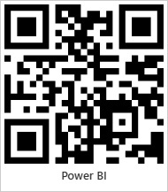



Thank You!
Taher Abdelfattah
Maged Mohamed
Taher.Abdelfattah@hotmail.com
magedhendam425@gmail.com
+201005776443
+201004312580
Sandra Shenouda
Mahmoud Abdelqader
sandrashenod@gmail.com
Mahmoud.abdulqader96@gmial.com
+201093734654
+201101122138

